Slide 1
Sustainable investing and fiduciary duty: Evidence from private equity (PART I)
Brunella Bruno
Bocconi University
13 NOVEMBER 2025

Slide 2
Agenda
Sustainable Investing and Fiduciary Duty - Preliminary Evidence
IS ESG INVESTING IN PRIVATE EQUITY (PE) CONSISTENT WITH FIDUCIARY DUTY?
1.0 Motivation
Why this topic matters today
A Polarized ESG Landscape?
2.0 Private Equity and ESG Integration
The Core Dilemma of Fiduciary Duty
What theory predicts
3.0 Studies on PE and ESG investing
Where We Stand in the Literature
Our Research Questions and Hypotheses

Slide 3
Motivation
1.0

Slide 4
Motivation
Sustainable Investing and Fiduciary Duty - Preliminary Evidence
IS ESG INVESTING IN PE CONSISTENT WITH FIDUCIARY DUTY?
Why This Debate Matters Now
ESG investing has grown beyond $30 trillion globally (Global Sustainable Investment Alliance, 2023).
Geopolitical and political shifts complicate priorities:
Energy security vs. climate goals after global conflicts.
Rising inequality and social unrest heighten calls for responsible capital.
Anecdotal evidence:
BlackRock and Vanguard halt ESG meetings after SEC crackdown – FT, 2024
BlackRock … left the Net Zero Asset Managers (NZAM) iniziative on Jan. 9 citing confusion over its climate efforts and legal inquiries from public officials – Reuters, 2025
State Street Investment Management withdraws its U.S. funds from NZAM in October 2025 – FT, 2025
The European Parliament's legal committee backed plans to water down the EU's corporate sustainability law – Reuters, 2025
Investors are under pressure to manage systemic climate and social risks
Can finance pursue social goals without breaching fiduciary duty?
Notes:
EU vs US divide: Europe mandates ESG; U.S. regulators curb it.
NZAM a few days ago slashes signatory requirements and dropped references to 2050 and specific targets

Slide 5
Motivation
Sustainable Investing and Fiduciary Duty - Preliminary Evidence
IS ESG INVESTING IN PE CONSISTENT WITH FIDUCIARY DUTY?
A Polarized ESG Landscape?
Policy and regulatory divergence:
EU → mandatory sustainability reporting (CSRD, SFDR).
U.S. → SEC restrictions on ESG coordination and shareholder proposals.
Different regulatory philosophies now shape investor incentives: Shareholder activism gap
Europe/UK: 81 % of ESG proposals supported (2024).
U.S.: only 20 % support; SEC’s new limits cut E- and S-resolutions sharply.
Reality is more nuanced
EU pension funds have reviewed or ended mandates with managers leaving NZAM or CA100+
U.S. reactions are mixed — some asset owners review mandates post-exit, others scale back ESG demands amid political pressure.
Source: FT, 2025
Notes:
EU vs US divide: Europe mandates ESG; U.S. regulators curb it.

Slide 6
Private equity and esg integration
2.0

Slide 7
The core dilemma of fiduciary duty
Sustainable Investing and Fiduciary Duty - Preliminary Evidence
IS ESG INVESTING IN PE CONSISTENT WITH FIDUCIARY DUTY?
From “Value” to “Values”: The Root of the Divide
Fiduciary duty traditionally = maximize financial returns for beneficiaries.
Sustainable investing broadens this to include long-term systemic risks (climate, inequality, governance).
This creates distinct investment behaviors:
Risk Minimizers: ESG
as essential to long-term value and risk control
Value Maximizers:
ESG only if it boosts short-term returns
Impact Investors: ESG integrated to achieve dual objectives of financial performance and positive societal impact
Notes:
The divergent ESG responses seen earlier — SEC restrictions in the U.S., renewed inflows in Europe, and contradictory reactions to the relaxation of ESG requirements and targets — may stem from different interpretations of fiduciary duty.
Traditionally, fiduciary duty has meant a narrow obligation to maximize financial returns for beneficiaries.
In sustainable and responsible investing, this duty is reinterpreted to include long-term value preservation and the management of systemic risks such as climate change and social instability.
These contrasting interpretations drive distinct investment behaviors:
Some investors treat ESG as a financial instrument — a tool for efficiency and risk mitigation.
Others see it as a responsibility — a commitment to align capital with broader sustainability outcomes.
The resulting tension explains the polarized ESG landscape we see today.

Slide 8
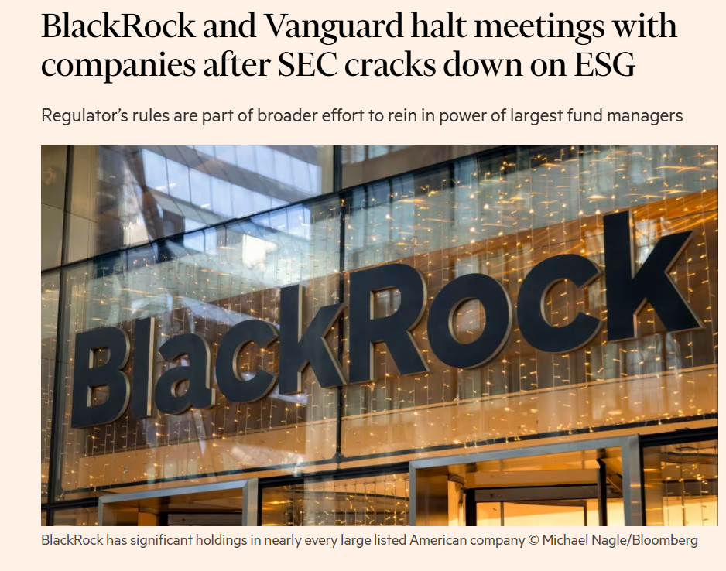
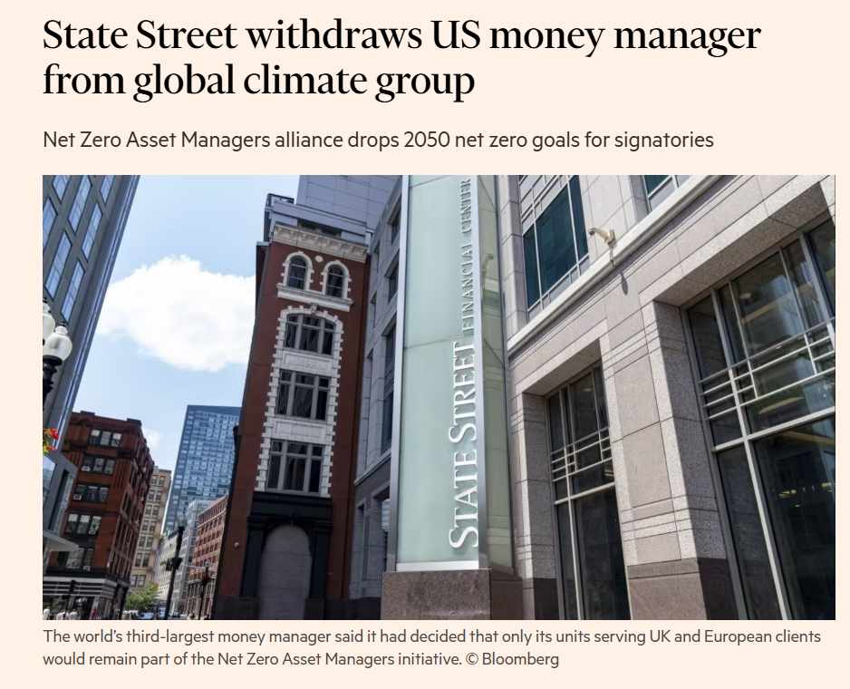
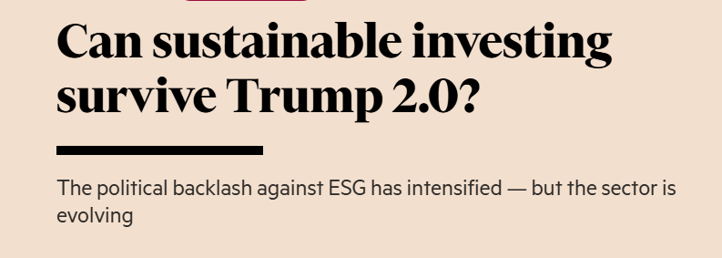
“ESG as a risk management technique.”
“…A company with a good ESG rating shouldn’t be doing too much damage to the environment, shouldn’t be treating its workers too terribly and shouldn’t have a terrible corporate structure, because these things could constitute financial risks.” (FT, 2025)
The ESG divide isn’t just political — it’s about what acting in investors’ best interests really means
Notes:
ESG less slogan and more risk management technique?

Slide 9
Fiduciary duty in private markets
Sustainable Investing and Fiduciary Duty - Preliminary Evidence
IS ESG INVESTING IN PE CONSISTENT WITH FIDUCIARY DUTY?
What theory predicts
PE firms should be more inclined to integrate ESG factors within their fiduciary duty obligations. Why?
Sustainability can increase long-term value by providing a competitive advantage or as a regulatory and reputational risk management strategy.
PE can realize the financial benefits of ESG improvements internally through operational control — rather than depending on external market recognition. E.g.:
A PE could invest in industrial firms and upgrades their energy systems — not just to look “green,” but to cut costs, increase margins, and raise the value of those firms at exit.
Private Equity | Public Markets
Long-term horizon | Short-term focus
Active ownership | Dispersed ownership
Strategic ESG integration | ESG via screening/exclusion
Direct value capture | Market-based returns
But is this always the case?
Notes:
In private equity, investors don’t just hold shares — they actively manage portfolio companies. That means when they implement operational improvements or ESG initiatives, they can directly capture the financial benefits of those changes, rather than relying on the market to recognize them through share price movements.
In Practice
- A public investor (e.g., a mutual fund) can only influence ESG outcomes indirectly — mainly through voting or engagement. Their returns depend on how markets reprice the stock.
- A PE investor (as owner) can directly improve performance — for example, by: Reducing energy costs (efficiency gains → higher margins).
Strengthening governance (lower risk → higher valuation at exit).
Rebranding a cleaner, more responsible business (enhanced buyer interest at exit).
Because the PE fund controls strategy and operations, the value created by ESG actions flows directly into the firm’s cash flows and exit valuation, not mediated by market perception.
In Short:
Direct value capture means that private equity can realize the financial benefits of ESG improvements internally through operational control — rather than depending on external market recognition, as public investors do.

Slide 10
Studies on Pe and esg investing
3.0

Slide 11
Studies on PE and ESG investing
Sustainable Investing and Fiduciary Duty - Preliminary Evidence
IS ESG INVESTING IN PE CONSISTENT WITH FIDUCIARY DUTY?
Where we stand in the literature
Sustainability is still a niche topic in the PE literature
Empirical evidence remains mixed, especially in private markets, where ESG can be both strategic (→ increase value, reduce risk, attract investors) and ethical value driven (→ meet social or reputational expectations)
View | Core Argument | Investor Approach | Main Studies
Compatibility View | ESG improves long-term risk-adjusted returns → consistent with fiduciary duty | Risk-focused | Lins et al. (2017); Chava (2014); Barber et al. (2021)
Conflict View | ESG sacrifices returns for social aims → breaches fiduciary duty | Return-maximizing | Gillan et al. (2021); classical finance theory
Private Markets Perspective | Active ownership allows ESG to enhance firm value → non pecuniary utility to compensate lower return | Hybrid (impact investing) | Barber et al. (2021); Gryglewicz et al. (2025)

Slide 12
Studies on PE and ESG investing
Sustainable Investing and Fiduciary Duty - Preliminary Evidence
IS ESG INVESTING IN PE CONSISTENT WITH FIDUCIARY DUTY?
Our research questions and hypotheses
RQ1: What is the role of PE ownership in shaping ESG performance at portfolio companies?
RQ2: Does activist PE ownership improve ESG performance at portfolio companies?
RQ3: What is the role of fiduciary duty in shaping ESG performance in PE-backed firms?
H1: Portfolio companies improve ESG performance under PE ownership.
H2: Activist PE firms drive stronger ESG gains by committing more resources and oversight, reflecting a deeper fiduciary engagement to sustainability.
H3: Political, regulatory, or climate shocks that heighten investors’ attention to fiduciary duty, reshape ESG priorities and influence portfolio outcomes of PE investors.
Notes:
We aim to fill this gap in the literature and contribute to the debate by focusing on the role of PE in ESG investing
The extent of improvement depends on how PE firms interpret fiduciary duty—those with a long-term, value-maximization focus treat sustainability as a competitive
and risk-management advantage.

Slide 13
THANKS.

Slide 14
Sustainable investing and fiduciary duty: Evidence from private equity (Part ii)
Carlo Chiarella
CUNEF Universidad and Bocconi University
13 NOVEMBER 2025

Slide 15
Agenda
Sustainable Investing and Fiduciary Duty - Preliminary Evidence
IS ESG INVESTING IN PRIVATE EQUITY CONSISTENT WITH FIDUCIARY DUTY
A FIRST LOOK INTO THE EVIDENCE FROM OUR STUDY
1.0 Database
Data sourcing, cleaning, panel creation and integration of private equity (PE) ownership and ESG information
Sample descriptive statistics
Summary of ESG variables description
Descriptive Evidence: distribution of reputational risk ratings, and summary comparisons of environmental incidents and reputational risk measures across PE ownership status
2.0 Empirical Analyses
Two-way fixed effects OLS regression to identify association of PE ownership status and Socially Responsible Investment (SRI) activism, with environmental incidents and reputational risk measures
Event study regression to identify dynamic effects around PE or SRI PE acquisitions and distinguish selection (pre-entry dynamics) vs. ownership effects (post-entry outcomes)

Slide 16
database
1.0

Slide 17
Database
Sustainable Investing and Fiduciary Duty - Preliminary Evidence
IS ESG INVESTING IN PRIVATE EQUITY CONSISTENT WITH FIDUCIARY DUTY
SAMPLE CONSTRUCTION AND DESCRIPTIVE STATISTICS
Data sourcing, cleaning, panel creation and integration of PE ownership and ESG information
US Company Universe (S&P Capital IQ)
PE Entry/Exit (constructed from S&P Capital IQ transaction-level data by tracking ownership timelines)
PE Sustainable and Responsible Investment Activism (UN PRI signatory status)
Company ESG Reputational Risk Measures (RepRisk)
Data Caveats and ESG Reporting Limitations:
Coverage of private companies in standard databases is limited, reducing the sample size
Database construction required extensive matching across sources based on company and PE names, introducing some classification uncertainty
ESG data reflects disclosure and visibility patterns as well as underlying ESG trends
Classification of PE firms by SRI orientation involves simplifications, posing limitations for benchmarking ESG delivery across peers

Slide 18
Database
Sustainable Investing and Fiduciary Duty - Preliminary Evidence
IS ESG INVESTING IN PRIVATE EQUITY CONSISTENT WITH FIDUCIARY DUTY
SAMPLE CONSTRUCTION AND DESCRIPTIVE STATISTICS
Sample description
The dataset contains 3,872 unique companies observed for 18 years between 2007 and 2024: totaling 69,264 company-year observations
3,353 companies are private and 494 public
 | Full sample | w/incident (env.) | Ex.-Financials | w/incident (env.)
Unique firms | 3,874 | (358) | 1,487 | (179)
PE-Backed firms | 711 | (50) | 569 | (44)
SRI PE-Backed firms | 87 | (7) | 72 | (7)

Slide 19
Database
Sustainable Investing and Fiduciary Duty - Preliminary Evidence
IS ESG INVESTING IN PRIVATE EQUITY CONSISTENT WITH FIDUCIARY DUTY
SAMPLE CONSTRUCTION AND DESCRIPTIVE STATISTICS
Sample distribution across environmentally relevant industry groups
About 18% of all companies are in environmentally intensive sectors
Among PE and SRI PE-backed companies the share of these sectors drops to 12% and 15%, respectively, suggesting underweighting
 | All | PE | SRI PE
Energy | 7% | 5% | 8%
Materials | 5% | 4% | 3%
Utilities | 5% | 1% | 1%
Transportation | 1% | 2% | 3%
 | 18% | 12% | 15%

Slide 20
Database
Sustainable Investing and Fiduciary Duty - Preliminary Evidence
IS ESG INVESTING IN PRIVATE EQUITY CONSISTENT WITH FIDUCIARY DUTY
SAMPLE CONSTRUCTION AND DESCRIPTIVE STATISTICS
Sample breakdown by ESG risk exposure ratings
Only 6% PE-backed companies and about 5% of those backed by SRI PEs have moderate or high ESG risk exposures (ratings at or below BBB), compared to 8% for non-PE-backed companies
A smaller share of SRI PE-backed companies have AAA or AA ratings (57% vs 68% for non-SRI PE), but more have A ratings (38% vs 26%)
 | ESG Risk Exposure (RepRisk ratings combining a company’s own ESG, reputational, and business-conduct risk exposure with that of the countries and sectors in which it operates)
 | Low |  |  | Moderate |  |  | High
 | AAA | AA | A | BBB | BB | B | CCC | CC | C | D
Overall | 9% | 59% | 25% | 6% | 1% | <1% | <1% | <1% | <1% | <1%
Non-PE-Backed | 9% | 59% | 25% | 6% | 1% | <1% | <1% | <1% | - | -
PE-Backed | 9% | 59% | 26% | 4% | 1% | <1% | <1% | <1% | <1% | <1%
SRI PE-Backed | 5% | 52% | 38% | 3% | 1% | <1% | - | - | - | -

Slide 21
Database
Sustainable Investing and Fiduciary Duty - Preliminary Evidence
IS ESG INVESTING IN PRIVATE EQUITY CONSISTENT WITH FIDUCIARY DUTY
VARIABLES DESCRIPTION
Measuring ESG reputational risk exposures at portfolio company level (based on information from RepRisk)
Variable | Definition | Aggregation (Company-Year)
Reputational Risk Index (RRI) | Risk score (0=min – 100=max) reflecting recent exposure to ESG and business conduct risks, on the frequency and severity of ESG-related controversies reported in media, stakeholder, and third-party sources. | Twelve months average, min, max or value as of year end
Environment | Indicator of environmental incident | Sum of all incidents in the year
Severe | Indicator of severe environmental incident (1= less severe; 2=severe; 3=very severe) | Sum of all incidents in the year, where severity >1
Reach | Indicator of reach of environmental incident on public sources (1= limited reach; 2=medium reach; 3=high reach) | Sum of all incidents in the year, where reach >1
Novel | Indicator of environmental incident that is new to the company (1=re-occurring issue; 2=new issue) | Sum of all incidents in the year, where novelty equals 2

Slide 22
Database
Sustainable Investing and Fiduciary Duty - Preliminary Evidence
IS ESG INVESTING IN PRIVATE EQUITY CONSISTENT WITH FIDUCIARY DUTY
DESCRIPTIVE EVIDENCE
Summary statistics of key ESG variables
PE-backed companies experience fewer environmental incidents on average than non-PE-backed ones, especially as regards more severe incidents or incidents with a broader reach
Within PE-backed companies, those backed by SRI PEs show relatively more environmental incidents on average
SRI PE-backed companies also show higher RRI scores, indicating higher reputational risk exposure
 | All Sample |  |  |  | No-PE | PE-Backed |  | SRI PE-Backed
 | Mean | Std Dev | Min | Max | Mean | Mean | T-test of Diff. | Mean | T-test of Diff.
RRI (avg.) | 0.90 | 3.90 | 0.00 | 76.00 | 0.91 | 0.89 | 0.01 | 2.48 | 1.49***
Environment | 0.03 | 0.34 | 0.00 | 16.00 | 0.03 | 0.02 | -0.01** | 0.09 | 0.08***
Severity | 0.01 | 0.14 | 0.00 | 9.00 | 0.01 | 0.00 | -0.01*** | 0.03 | 0.03***
Reach | 0.01 | 0.20 | 0.00 | 6.00 | 0.02 | 0.01 | -0.01** | 0.04 | 0.04***
Novelty | 0.01 | 0.13 | 0.00 | 6.00 | 0.01 | 0.01 | 0.00 | 0.03 | 0.02**
Notes:
This slide offers an initial snapshot of differences in ESG outcomes across ownership types. It compares average ESG risk exposure and the frequency of environmental incidents between PE-backed and non-PE-backed companies, and, within PE ownership, between firms backed by ESG-active investors (SRI) and other PE firms. Asterisks indicate statistically significant differences in mean values.
Tests of differences in means do not account for underlying firm characteristics that can influence ESG outcomes independently of ownership nor sector-wide dynamics. Therefore, the sign of a difference should not be interpreted as causal. A negative difference could signal either a genuine improvement after acquisition or the selection of already “cleaner” companies. Similarly, a positive one does not necessarily mean a deterioration but could signal instead the selection of riskier firms that PE hope to improve. The later analyses are help us start disentangling these possibilities.

Slide 23
Empirical analyses
2.0

Slide 24
Preliminary Evidence
Sustainable Investing and Fiduciary Duty - Preliminary Evidence
IS ESG INVESTING IN PRIVATE EQUITY CONSISTENT WITH FIDUCIARY DUTY
TWO WAY FIXED EFFECT OLS REGRESSION
Coefficient Estimation (caution in interpretation: identifies associations, not causality)
PE ownership, especially by SRI PEs, is associated with significantly more environmental incidents and higher RRI scores.
RRI rises by approx. 1 point upon the entry of a SRI PE, but only by 0.2 points otherwise
Environmental incidents increase by approx. 3.5% upon entry of a SRI PE, but only by 0.4% otherwise
 | RRI | Ln(1+ Environment) | Ln(1+Severity) | Ln(1+Reach) | Ln(1+Novelty)
PE-Backed | 0.2350*** | 0.0041** | 0.0005 | 0.0019 | 0.0018
 | 0.0771 | (0.0017) | (0.0007) | (0.0014) | (0.0013)
SRI PE-Backed | 0.6928*** | 0.0302*** | 0.0112* | -0.0129* | -0.0002
 | (0.2572) | (0.0102) | (0.0060) | (0.0030) | (0,0071)
Company f.e. | Yes | Yes | Yes | Yes | Yes
Industry-year f.e. | Yes | Yes | Yes | Yes | Yes
Obs. | 22,520 | 22,521 | 22,521 | 22,521 | 22,521
R-squared | 0.45 | 0.30 | 0.20 | 0.23 | 0.18
Notes:
This slide summarizes the results of a regression that looks at how ESG outcomes evolve within firms over time depending on ownership status, after controlling for firm characteristics and industry-wide changes. By including firm fixed effects, the model accounts for each company’s inherent characteristics that do not change over time (e.g., sector, size, or location). Industry-year fixed effects further control for external factors that affect all firms within a given sector and year, such as regulatory changes or macroeconomic trends. This model specification ensures we are comparing companies to themselves over time rather than across sectors.
Asterisks indicate statistically significant coefficient estimates. However, they capture association rather than causation, so we recommend caution in interpreting results. That is, they indicate that companies owned by PE and among them ESG-active investors tend to report more incidents and higher reputational risk, but this does not imply that ownership causes the increase.
Possible explanations are discussed in the next slide

Slide 25
Preliminary Evidence
Sustainable Investing and Fiduciary Duty - Preliminary Evidence
IS ESG INVESTING IN PRIVATE EQUITY CONSISTENT WITH FIDUCIARY DUTY
TWO WAY FIXED EFFECT OLS REGRESSION
Preliminary evidence challenges the prior expectation of PE superior stewardship
Alternative hypotheses that may reconcile this tension:
Selection effects: PE and (even more so) SRI PEs may select companies with better/worse environmental track records and lower/higher reputational risk exposure pre-acquisition, confounding post-acquisition improvements
Signaling: PE and (even more so) SRI PEs may adopt disclosure commitments at the level of portfolio companies to manage their reputational exposure, leading to increased transparency and reporting of controversies without reflecting true deterioration
Visibility and disclosure paradox: PE and (even more so) SRI PEs may select high-profile companies that already are or will become more exposed to external scrutiny from investors, regulators, and media, leading to higher baseline ESG reputational risk, inflating ESG risk measures
Notes:
Selection effect: it could well be that SRI PE deliberately select companies with worse environmental track record/higher reputational risk because their intention is – thanks to their active involvement in the company management activity – to improve the firm’s performance during the holding period.

Slide 26
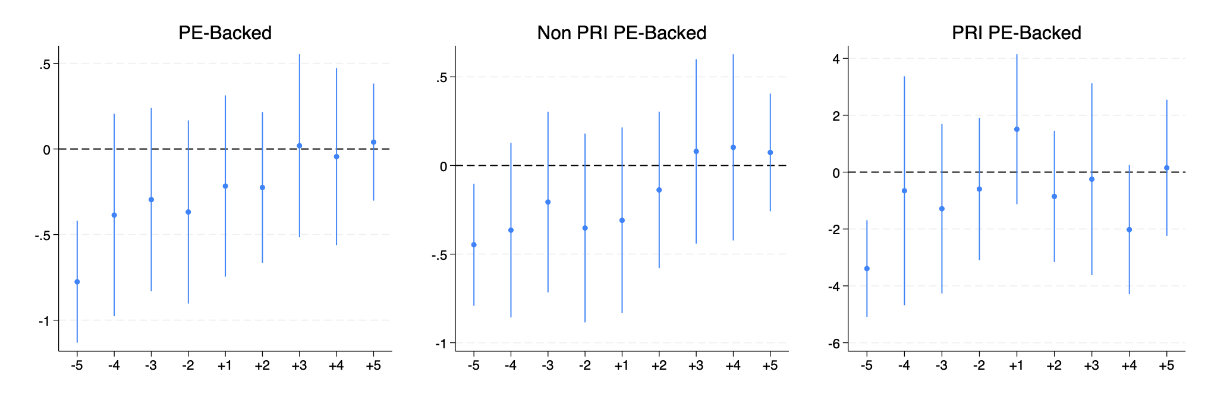
Preliminary Evidence
Sustainable Investing and Fiduciary Duty - Preliminary Evidence
IS ESG INVESTING IN PRIVATE EQUITY CONSISTENT WITH FIDUCIARY DUTY
EVENT STUDY DYNAMIC EFFECT
RRI score (average annual value) before and after PE entry (red line)
Firms acquired by both SRI and non-SRI PEs show lower reputational risk (RRI) in the pre-acquisition period, but there is no systematic improvement or deterioration after entry
Notes:
This slide presents the results of an event-study analysis that tracks how companies’ reputational risk (RRI) evolves in the years surrounding their acquisition by PE, in general (left panel) and depending on their SRI orientation (ceter and right panels).
The goal of this model is to test whether ESG performance changes after acquisition, or whether the differences we observed in earlier regression results are already visible before PE entry. The analysis estimates average changes in RRI for each year relative to the acquisition year, which serves as the reference category. This means all coefficients shown on the graph represent differences in average RRI compared with the year of acquisition, after controlling for firm-specific characteristics and broad industry-year shocks.
Only the estimates for five years before acquisition are statistically significant (zero is outside of their confidence intervals), and they are negative. This suggests that target firms had lower reputational risk before PE ownership began. In contrast, coefficients for the years immediately before and after the acquisition hover around zero, indicating no significant change after entry.
This pattern implies that what might appear as “higher ESG risk under PE ownership” in the earlier regression results likely reflects selection effects (who gets acquired) rather than ownership effects (what happens after acquisition). The flat line after year 0 suggests that PE entry itself does not systematically alter reputational exposure, reinforcing the interpretation that prior differences and visibility dynamics drive the observed associations.

Slide 27
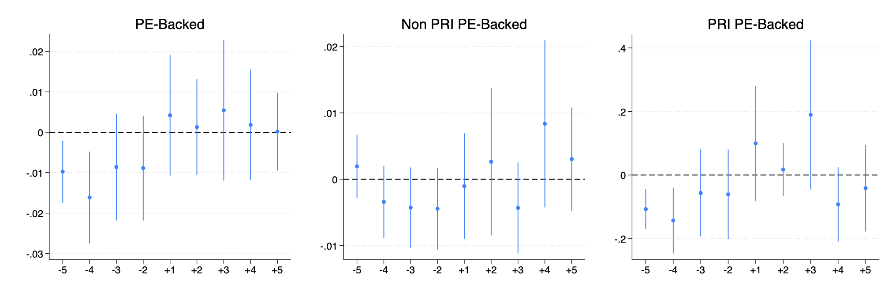
Preliminary Evidence
Sustainable Investing and Fiduciary Duty - Preliminary Evidence
IS ESG INVESTING IN PRIVATE EQUITY CONSISTENT WITH FIDUCIARY DUTY
EVENT STUDY DYNAMIC EFFECT
Number of environmental incident before and after PE entry (red line)
Firms acquired by SRI PEs show fewer incidents in the pre-acquisition period, but there is no systematic improvement or deterioration after entry
Notes:
Using the same setup as in the previous slide, but focusing on environmental incidents, we again compare firms to their own baseline in the acquisition year. The only significant differences appear four to five years before PE entry, showing that SRI PE targets already had fewer incidents before being acquired. There’s no clear change afterward, reinforcing that the patterns reflect selection, not ownership effects.

Slide 28
Preliminary Evidence
Sustainable Investing and Fiduciary Duty - Preliminary Evidence
IS ESG INVESTING IN PRIVATE EQUITY CONSISTENT WITH FIDUCIARY DUTY
WRAP-UP
Core findings at this stage
Companies backed by PEs, especially by SRI PEs, display more environmental incidents and higher RRI scores, but the positive association found in the OLS regressions is likely driven by selection effects and visibility dynamics rather than underperformance
Before the acquisition, companies later backed by SRI PEs show lower reputational risk (RRI) and fewer incidents (Environment)
After acquisition there is no systematic improvement or deterioration
Interpretation and open questions:
These results suggest differences in ESG outcomes are not ownership driven, but stem from pre-existing characteristics rather than causal ownership impacts
PE may have been selecting either “cleaner” assets to signal low risk or more problematic but improvable ones to turn them around through stewardship
PE may have been selecting high-profile companies, which face greater scrutiny from media, regulators, and investors. Once ownership changes, no further change occurs because disclosure practices and the level of external attention was already elevated.
Notes:
This slide brings together the main findings from the analysis.
Across methods, we see that PE ownership, especially by SRI ones, is associated with higher reported ESG risks and more environmental incidents, but that these differences are already present before acquisition and do not change significantly afterward.
The evidence therefore points to selection and visibility dynamics rather than causal ownership effects: SRI PE funds may target firms that already differ in risk profile or that attract greater public and regulatory attention, leading to more disclosure and scrutiny, not necessarily worse ESG performance.
In other words, the results highlight a key tension: while ESG integration in private equity may serve fiduciary and reputational objectives, its transformational impact on portfolio companies’ ESG outcomes remains an open empirical question motivating the project’s next phase.

Slide 29
Preliminary Evidence
Sustainable Investing and Fiduciary Duty - Preliminary Evidence
IS ESG INVESTING IN PRIVATE EQUITY CONSISTENT WITH FIDUCIARY DUTY
NEXT STEPS
Form associations to causal inference via fiduciary duty:
Do exogenous shocks to (i) political sentiment (e.g., electoral shifts) and/or (ii) investor attention (e.g., extreme events) to climate risk moderate the effect of PE ownership on ESG risk exposure (RRI) and environmental incidents?
Intuition: heightened fiduciary attention induces mitigation, especially among SRI PEs

Slide 30
THANKS.

