Slide 1
Climate change and infrastructure asset Pricing
Carlo Chiarella
CUNEF Universidad and Bocconi University
13 NOVEMBER 2025

Slide 2
Agenda
Observatory #4 – Climate Change
  1.0 Infrastructure investing and climate change
    Physical risk and transition risk of infrastructure assets
    The view of investors and managers
  2.0 Pricing climate risk
    What we know from the literature
    What we have done and what we know now: the price of climate risk
    The drivers of the climate risk premium

Slide 3
Infrastructure investing and climate change
1.0

Slide 4
Pricing infrastructure
Observatory #4 – Climate Change
KEY CLIMATE CHANGE RISKS
TRANSITION RISK
What is it. Risks to cash flows and valuations from the shift to a low-carbon economy:
  New regulations (e.g., carbon pricing, emissions caps, disclosure mandates, environmental standards)
  Technology disruption (e.g., advances in renewables, storage, electric mobility, and digital efficiency)
  Market demand shifts (e.g., electrification, decentralization, changing end-user preferences)
  Legal/reputational issues (e.g., litigation risk, stakeholder activism and evolving ESG sentiment)
What is means for infrastructure operating and investment fundamentals.
  Capex and financing gaps (adaptation of assets to new technologies or usage patterns, higher upfront investment needs, risk of stranded assets)
  Operational and reliability risk (system integration challenges as technology and consumer behaviour change, volatility of input costs, congestion or balancing costs)
  Market and pricing risk (volume, tariff, or reutilization shifts, potential re-pricing of contracts or concessions)
  Lenders and investors’ ESG preferences affecting project hurdle rates and bid prices

Slide 5
Pricing infrastructure
Observatory #4 – Climate Change
KEY CLIMATE CHANGE RISKS
PHYSICAL RISK
What is it. Exposure to acute climate events (storms, floods, heatwaves, wildfires) and environmental shifts (sea-level rise, drought, heat) that can:
  Damage assets and impair operations
  Increase operating and maintenance costs (e.g., more frequent repairs, system upgrades)
  Reduce asset availability and demand (e.g., service interruptions, usage constraints)
What is means for infrastructure operating and investment fundamentals. .
  Material portfolio exposure: some investors could lose >50% of portfolio value by 2025 under severe climate scenarios (EDHECinfra 2024 Survey)
  Operational and financial impact: downtime, repair and replacement capex, higher O&M and insurance premia, potential penalties or tariff adjustments under regulatory frameworks.
  Asset- and location-specific vulnerability: physical risk depends on geography, design, and asset type, making it difficult to diversify within typically concentrated infra portfolios.
  Lenders and investors increasingly factoring resilience and adaptation measures into cost of capital, covenants, and asset pricing

Slide 6
Pricing infrastructure
Observatory #4 – Climate Change
KEY CLIMATE CHANGE RISKS
THE POINT OF VIEW OF INVESTORS AND ASSET MANAGERS
Investors recognize climate risk as financially material and are stregthening ESG frameworks, but there remains a gap in the portfolio-level risk management.
What infrastructure investors say: (from EDHEC Infra 2024 Climate Risk Survey, and PREQIN 2024 ESG Survey)
  97% consider physical climate risk significant for portfolios
  76% expect a medium or high financial impact within their investment horizon
  Only 16% feel they understand well how it will affect specific assets
  Roughly to-thirds have not yet conducted portfolio-level climate risk assessments
  Around 50% now have a formal ESG or climate policy in place
  24% have already rejected deals over ESG/climate concerns; 36% say they would in future

Slide 7
Pricing CLIMATE RISK
2.0

Slide 8
Pricing Climate Risk
Observatory #4 – Climate Change
WHAT WE KNOW FROM THE LITERATURE
THE CLIMATE RISK PREMIUM
Theoretical channel I: Risk compensation. Assets with higher climate exposure (“brown”) should offer higher expected returns as compensation for bearing systematic climate risks
  Assets exposed to climate risk (e.g., coastal real estate, municipal bonds, and corporate equities in vulnerable sectors) consistently show higher required returns or lower prices (Giglio et al., 2021)
  Firms with higher carbon emissions (Scope 1 & 2) earn higher average returns, especially in high-emission sectors and jurisdictions with weaker carbon policy (Bolton and Kacperczyk, 2021)
  Stocks more exposed to rising carbon prices show 3–4 % p.a. higher expected returns. Premium intensifies after major policy shocks (Bolton and Kacperczyk, 2022)
Theoretical channel II: Valuation sentiment. Investors preference for assets with low climate exposure (“green”) should drive their prices upward and reduce their expected return
  ESG-sensitive investors bid up green assets, underweighting high-emission investments and accepting lower returns for more sustainable ones (Stroebel and Wurgler, 2021)
  When climate concern / ESG fund inflows rise, green stocks outperform short-term (valuation repricing), then deliver lower expected returns (~30–60 bps p.a. discount) (Pastor et al., 2022)

Slide 9
Pricing Climate Risk
Observatory #4 – Climate Change
WHAT WE KNOW FROM THE LITERATURE
THE CLIMATE RISK PREMIUM
Measuring the “Greenium”: valuation premium (or lower expected return) associated with green assets compared to brown ones.
  GMB (Green-Minus-Brown factor)
  Realized return differential between portfolios of green and brown firms, ranked by ESG score (Bolton and Kacperczyk, 2021)
  PST (Green Preference factor)
  Model-implied factor reflecting valuation shocks (or expected-return adjustments) arising from time-varying demand for green assets; complements GMB by isolating the taste/valuation channel of climate risk pricing based on ESG-fund flows, survey-based climate concern indices, and green-news (Pastor et al., 2022)

Slide 10
Pricing Climate Risk
Observatory #4 – Climate Change
WHAT WE HAVE DONE AND WHAT WE KNOW NOW
TESTING PRICING ANOMALIES FOR INFRASTRUCTURE ASSETS
Single-index regressions:
$r_{t}=α_{}+{β_{FF5}^{′}x}_{t}+{{β_{GMB}^{′}GMB}_{t}+{β_{PST}^{′}PST}_{t}+ε}_{t}$
Indices | Risk Factors
(2000-pres.) Unlisted infrastructure: Preqin Infrastructure (2008-pres.) EDHEC Infra300 Equity (2000-2022) MSCI World Private Infrastructure (2008-pres.) Power/Water/Communication/Transportation Europe/North America/Australia Low/Moderate/High Risk Economic/Social Greenfield/Brownfield Contracted/Uncontracted Regulated/Partially/Unregulated | (2000-pres.) Traditional factors (Fama and French, 2015): Market Size Value Profitability Investment Climate risk factors (Pastor et al., 2022) Green-minus-Brown (GMB) Green Preference (PST)
Notes:
This is the core econometric model that underpins the analysis. It tests whether assets that are more exposed to climate risk earn different returns than those that are less exposed. In other words, it checks if investors require compensation for holding riskier (more exposed) assets (measured by the GMB factor), or whether strong demand for greener assets (measured by the PST factor) drives their prices up (and their expected returns down)

Slide 11

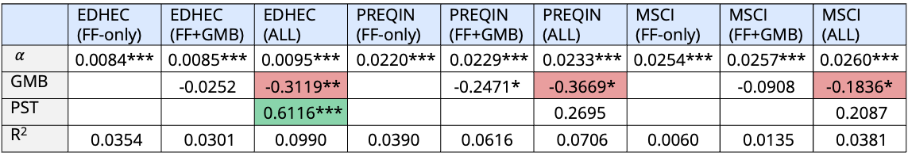
Pricing Climate Risk
Observatory #4 – Climate Change
WHAT WE HAVE DONE AND WHAT WE KNOW NOW
TESTING PRICING ANOMALIES FOR INFRASTRUCTURE ASSETS
Single-index stepwise regressions:
$r_{t}=α_{}+{β_{FF5}^{′}x}_{t}+{{β_{GMB}^{}GMB}_{t}+{β_{PST}^{}PST}_{t}+ε}_{t}$
  Climate factors are priced in aggregate infrastructure returns (R² increases with GMB and PST)
  Infrastructure indices behave like brown assets (negative GMB) offering a higher return in compensation for risk
  infrastructure valuations rise when investor preference for green assets strengthens (positive PST)
 | EDHEC (FF-only) | EDHEC (FF+GMB) | EDHEC (ALL) | PREQIN (FF-only) | PREQIN (FF+GMB) | PREQIN (ALL) | MSCI (FF-only) | MSCI (FF+GMB) | MSCI (ALL)
$α_{}$ | 0.0084*** | 0.0085*** | 0.0095*** | 0.0220*** | 0.0229*** | 0.0233*** | 0.0254*** | 0.0257*** | 0.0260***
GMB |  | -0.0252 | -0.3119** |  | -0.2471* | -0.3669* |  | -0.0908 | -0.1836*
PST |  |  | 0.6116*** |  |  | 0.2695 |  |  | 0.2087
R² | 0.0354 | 0.0301 | 0.0990 | 0.0390 | 0.0616 | 0.0706 | 0.0060 | 0.0135 | 0.0381
Notes:
In this slide we take a stepwise approach, adding one climate-risk variable (GMB and PST) at a time to see how each affects returns across three major private-infrastructure indices (EDHEC, PREQIN, MSCI). This allows us to test, whether exposure to climate risk helps explain differences in returns beyond standard risk factors.
Each coefficient in the table shows how sensitive returns are to a given climate-risk exposure. A positive sign means investors are compensated for taking that risk; a negative sign means the market places a valuation premium on greener assets (lower expected returns). Asterisks indicate statistical significance.
The R-squared shows how much of the return variation the model explains, and whether including climate variables improves our understanding of infra-asset pricing. What matters is whether adding climate-risk variables meaningfully increases R² , which is telling us if these additional risk factors help explain returns beyond traditional risk factors.

Slide 12
Pricing Climate Risk
Observatory #4 – Climate Change
WHAT WE HAVE DONE AND WHAT WE KNOW NOW
TESTING PRICING ANOMALIES FOR INFRASTRUCTURE ASSETS
Single-index regressions:
$r_{t}=α_{}+{β_{FF5}^{′}x}_{t}+{{β_{GMB}^{}GMB}_{t}+{β_{PST}^{}PST}_{t}+ε}_{t}$
 | MSCI Transport | MSCI Power Generation | MSCI Power Distribution | MSCI Water
GMB | -0.2240* | 0.0323 | -0.2136* | -0.2293**
PST | 0.2811 | -0.1386 | 0.1459 | 0.1664
R² | 0.0205 | -0.0119 | -0.0023 | 0.0056
Indices | Asset types | Climate Risk Exposure
MSCI Transport | Roads, ports, rail, airports, mixed | Extreme weather exposure, fuel dependence, demand linked
MSCI Power Generation | Gas, coal, and mixed fossil | Carbon exposure, fuel-price volatility
MSCI Power Distribution | Grid operators, T&D utilities | Storm/Heat exposure, congestion and reliability issues, regulated returns
MSCI Water | Water supply, wastewater treatment | Droughts/Floods exposure; regulated returns
Notes:
In this slide we run the full model specification separately on different groups of sector-based infrastructure indices to see whether climate risks are priced differently across industries.

Slide 13

Pricing Climate Risk
Observatory #4 – Climate Change
WHAT WE HAVE DONE AND WHAT WE KNOW NOW
TESTING PRICING ANOMALIES FOR INFRASTRUCTURE ASSETS
Single-index regressions:
$r_{t}=α_{}+{β_{FF5}^{′}x}_{t}+{{β_{GMB}^{}GMB}_{t}+{β_{PST}^{}PST}_{t}+ε}_{t}$
  At the sector level, climate pricing operates mainly through the risk compensation channel (negative GMB for transport, power distribution and water) rather than the valuation sentiment
    Climate change exposed sectors are associated with higher expected returns (negative GMB)
 | MSCI Transport | MSCI Power Generation | MSCI Power Distribution | MSCI Water
GMB | -0.2240* | 0.0323 | -0.2136* | -0.2293**
PST | 0.2811 | -0.1386 | 0.1459 | 0.1664
R² | 0.0205 | 0.0119 | 0.0023 | 0.0056
Notes:
In this slide we run the full model specification separately on different groups of sector-based infrastructure indices to see whether climate risks are priced differently across industries.

Slide 14
Pricing Climate Risk
Observatory #4 – Climate Change
WHAT WE HAVE DONE AND WHAT WE KNOW NOW
TESTING PRICING ANOMALIES FOR INFRASTRUCTURE ASSETS
Single-index regressions:
$r_{t}=α_{}+{β_{FF5}^{′}x}_{t}+{{β_{GMB}^{}GMB}_{t}+{β_{PST}^{}PST}_{t}+ε}_{t}$
 | MSCI Regulated | MSCI Unregulated | MSCI Contracted | MSCI Uncontracted | MSCI Economic | MSCI Social
GMB | -0.2439** | -0.1025 | -0.0827 | -0.2582* | -0.1933* | -0.1161
PST | -0.2582* | 0.1668* | 0.0697 | 0.3235* | 0.2055 | 0.2492*
R² | 0.0417 | -0.0004 | 0.0128 | 0.0404 | 0.0413 | 0.0179
Indices | Asset types | Climate Risk Exposure
MSCI Regulated | Energy/water networks, regulated utilities | Regulated tarriffs, cost pass-through, no economic cycle exposure
MSCI Contracted | PPAs, availability contracts | Regulated tarriffs, cost pass-through, no economic cycle exposure
MSCI Economic | Essential physical networks | Storm/Heat/Droughts/Floods exposure
MSCI Social | Schools, hospitals, social housing, justice | Direct social impact
Notes:
In this slide we run the full model specification separately on different groups of business-model-based infrastructure indices to see whether climate risks are priced differently across regulated, contracted or social infrastructure assets.

Slide 15
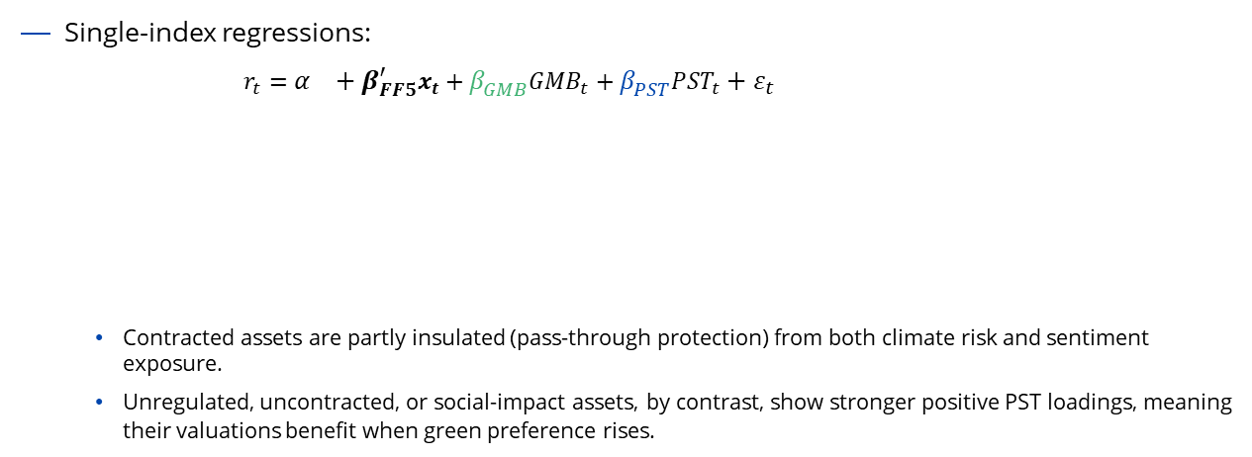
Pricing Climate Risk
Observatory #4 – Climate Change
WHAT WE HAVE DONE AND WHAT WE KNOW NOW
TESTING PRICING ANOMALIES FOR INFRASTRUCTURE ASSETS
Single-index regressions:
$r_{t}=α_{}+{β_{FF5}^{′}x}_{t}+{{β_{GMB}^{}GMB}_{t}+{β_{PST}^{}PST}_{t}+ε}_{t}$
  Contracted assets are partly insulated (pass-through protection) from both climate risk and sentiment exposure.
  Unregulated, uncontracted, or social-impact assets, by contrast, show stronger positive PST loadings, meaning their valuations benefit when green preference rises.
 | MSCI Regulated | MSCI Unregulated | MSCI Contracted | MSCI Uncontracted | MSCI Economic | MSCI Social
GMB | -0.2439** | -0.1025 | -0.0827 | -0.2582* | -0.1933* | -0.1161
PST | -0.2582* | 0.1668* | 0.0697 | 0.3235* | 0.2055 | 0.2492*
R² | 0.0417 | -0.0004 | 0.0128 | 0.0404 | 0.0413 | 0.0179
Notes:
In this slide we run the full model specification separately on different groups of business-model-based infrastructure indices to see whether climate risks are priced differently across regulated, contracted or social infrastructure assets.

Slide 16
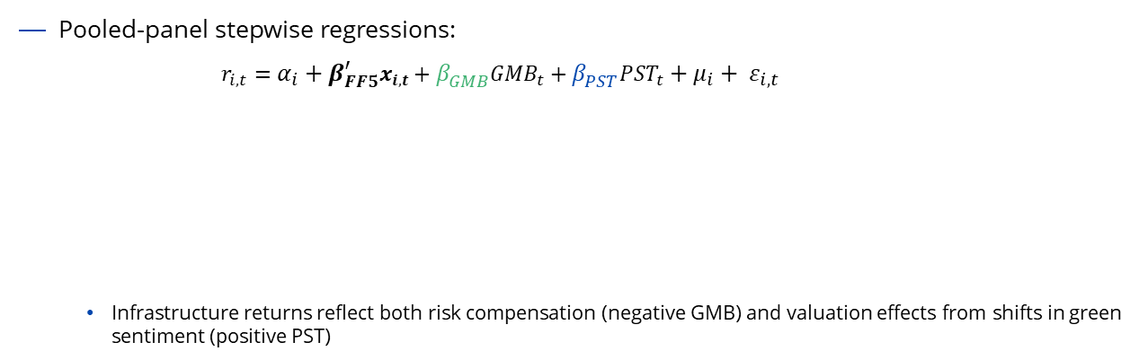
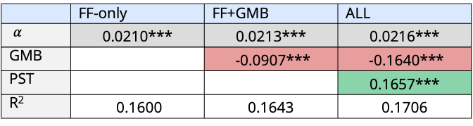
Pricing Climate Risk
Observatory #4 – Climate Change
WHAT WE HAVE DONE AND WHAT WE KNOW NOW
TESTING PRICING ANOMALIES FOR INFRASTRUCTURE ASSETS
Pooled-panel stepwise regressions:
$r_{i,t}=α_{i}+{β_{FF5}^{′}x}_{i,t}+{{β_{GMB}^{}GMB}_{t}+{β_{PST}^{}PST}_{t}+μ_{i}+ ε}_{i,t}$
  Infrastructure returns reflect both risk compensation (negative GMB) and valuation effects from shifts in green sentiment (positive PST)
 | FF-only | FF+GMB | ALL
$α_{}$ | 0.0210*** | 0.0213*** | 0.0216***
GMB |  | -0.0907*** | -0.1640***
PST |  |  | 0.1657***
R² | 0.1600 | 0.1643 | 0.1706
Notes:
In this slide all indices are analyzed together in a single model. This approach lets us use the full sample of observations, combining information across sectors, business models, and time to test whether the effects we observed earlier hold consistently across the infrastructure universe.
By controlling for time and index-specific effects, we isolate the systematic link between climate exposures and returns, rather than relationships that might be unique to one segment.
Once again, a stepwise approach allows us to test, whether exposure to climate risk helps explain differences in returns beyond standard risk factors by looking at the increase in R2.

Slide 17
Pricing Climate Risk
Observatory #4 – Climate Change
WHAT WE HAVE DONE AND WHAT WE KNOW NOW
TESTING PRICING ANOMALIES FOR INFRASTRUCTURE ASSETS
Pooled-panel regressions on targeted subsamples:
$r_{i,t}=α_{i}+{β_{FF5}^{′}x}_{i,t}+{{β_{GMB}^{}GMB}_{t}+{γ_{GMB}^{}GMB}_{t}x{INT}_{i}+{β_{PST}^{}PST}_{t}+{γ_{PST}^{}PST}_{t}x{INT}_{i}+{ρINT}_{i}+ μ_{i}+ ε}_{i,t}$
Channel | Target Subsample and Interaction Variable Construction (INT)
Physical risk (PX) | PX=0 Power Generation PX=1 Power Distribution, Water, Transport
Transition risk (TX) | TX=0 Power Distribution, Water TX=1Power Generation, Transport
Deman risk (DE) | DE=0 Uncontracted, Unregulated DE=1 Contracted, Regulated
Impact Pereference (IP) | IP=0 Economic IP=1 Social
Notes:
In this slide, we introduce interaction terms, which allow us to see through which channel the climate-risk effect operates.
We interact the climate-risk variables with dummies representing four channels identified in the literature: physical risk (PX), transition risk (TX), demand risk (DE) and impact preference (IP). Each dummy is a simple indicator variable that takes the value 1 if a given channel is active (depending on sector exposure) and 0 otherwise. By including these interactions, we can test whether the sensitivity of returns to climate risk changes together with the degree of exposure to the proposed channel.

Slide 18
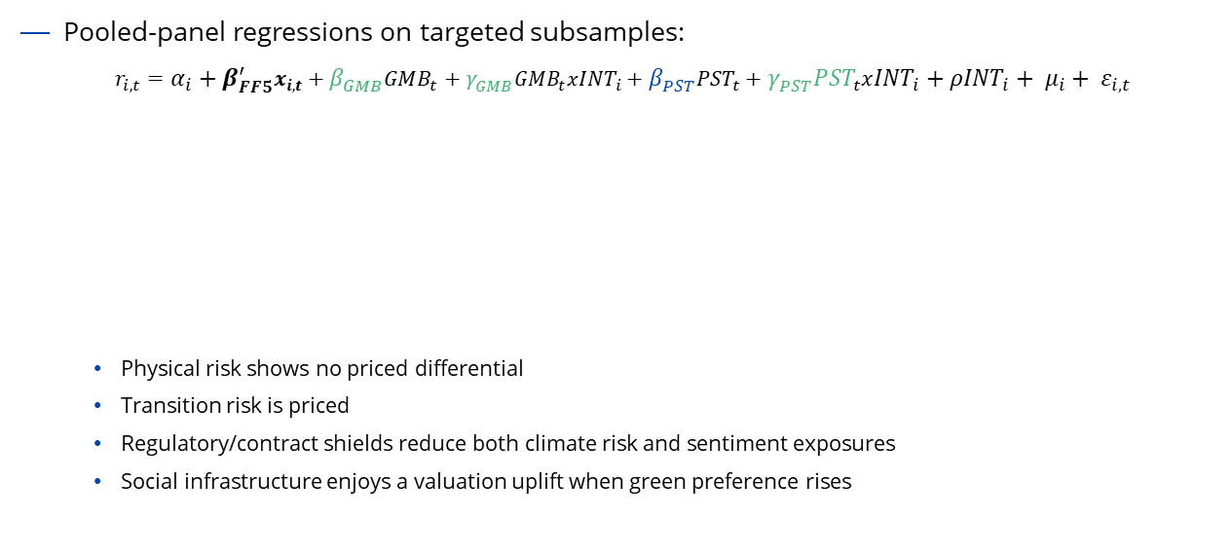
Pricing Climate Risk
Observatory #4 – Climate Change
WHAT WE HAVE DONE AND WHAT WE KNOW NOW
TESTING PRICING ANOMALIES FOR INFRASTRUCTURE ASSETS
Pooled-panel regressions on targeted subsamples:
$r_{i,t}=α_{i}+{β_{FF5}^{′}x}_{i,t}+{{β_{GMB}^{}GMB}_{t}+{γ_{GMB}^{}GMB}_{t}x{INT}_{i}+{β_{PST}^{}PST}_{t}+{γ_{PST}^{}PST}_{t}x{INT}_{i}+{ρINT}_{i}+ μ_{i}+ ε}_{i,t}$
  Physical risk shows no priced differential
  Transition risk is priced
  Regulatory/contract shields reduce both climate risk and sentiment exposures
  Social infrastructure enjoys a valuation uplift when green preference rises
 | Physical Risk Exposure | Transition Risk Exposure | Demand Risk Exposure | Impact Preference
GMB | -0.0496 | -0.2060** | -0.1719** | -0.1727*
GMBxINT | -0.1472 | 0.0914 | 0.0010 | 0.0269
PST | -0.0075 | 0.1478 | 0.2140** | 0.1557
PSTxINT | 0.1679 | -0.0591 | -0.0658 | 0.1602
R² | 0.1761 | 0.1752 | 0.1031 | 0.0179
Notes:
The table presents main coefficients and interaction terms from the pooled regression. It shows how climate-risk exposures affect returns on average (simple coefficients) and how those effects change depending on the dominant pricing channel (interaction terms). In particular, interaction terms combine the climate-risk variable with the dummy indicators of alternative channels, helping separate when climate exposure earns a risk premium and when it instead leads to a valuation discount.

Slide 19
THANKS.

