Slide 1
PRIVATE INFRASTRUCTURE AND SUSTAINABILITY:
DOES PRIVATE EQUITY PROMOTE FIRMS’ SUSTAINABLE PERFORMANCE?
Stefano Gatti
Antin IP Associate Professor of Infrastructure Finance
13 NOVEMBER 2025

Slide 2
Asset Under Management (AuM) by region focus: actual and forecasted volumes 2010-2029 ($ Bn)
Source: Preqin (2025)

Slide 3
Forecast Asset Under Management (AuM) growth by asset class, 2024-2029F
Source: Preqin (2025)

Slide 4
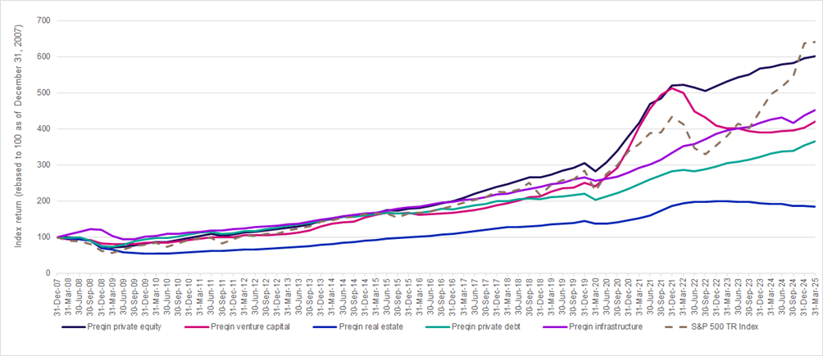
Performance of infrastructure vs other private capital and public benchmarks 2007-March 2025
Source: Preqin (2025), Global Infrastructure Report and Preqin (2025) Performance Pulse Q2 25

Slide 5
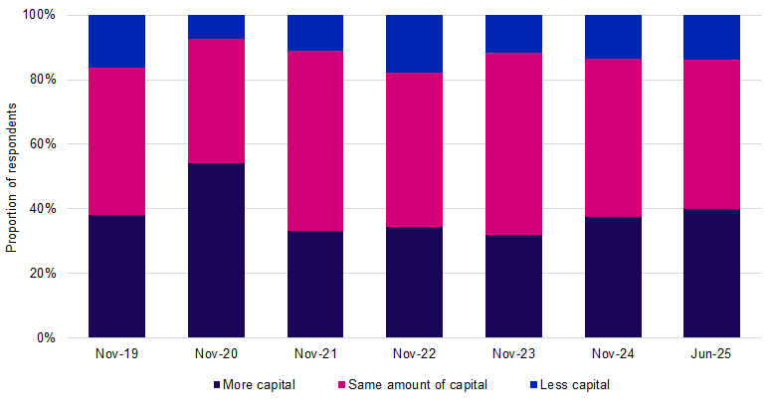
Short-term commitment plans (allocation plans for the next 12 months compared to the previous 12 months), 2019 – June 2025
Source: Preqin (2025), Investors’ Survey H2 2025

Slide 6
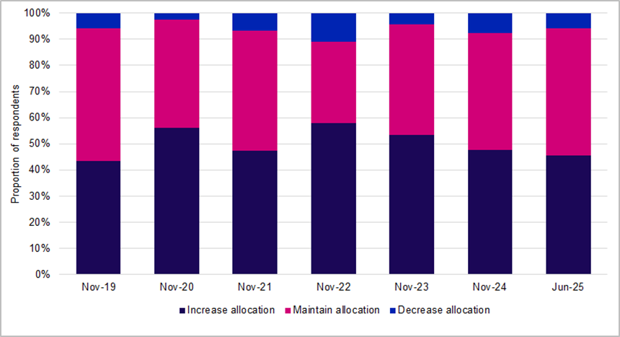
Investors’ intentions for their infrastructure allocations over the longer term, 2019 – June 2025
Source: Preqin (2025), Investors’ Survey H2 2025

Slide 7
Private and listed EV/EBITDA multiples – 2005-2024
Source: UBS (2025), Infrastructure Outlook 2025)

Slide 8
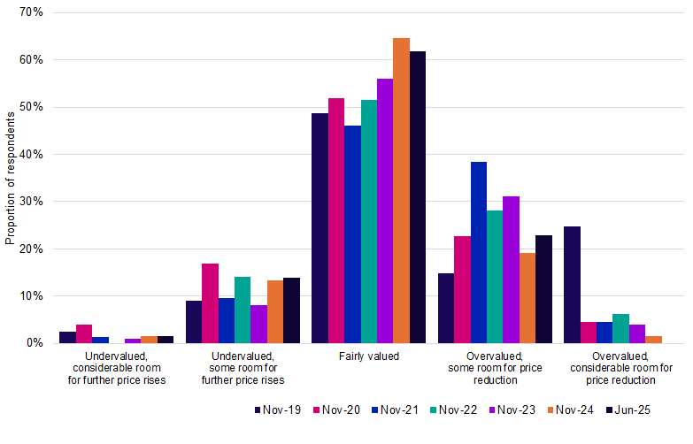
Perception of investors in terms of level of fairness of current prices of infrastructure assets 2019-June 2025
Source: Preqin (2025), Investors’ Survey H2 2025

Slide 9
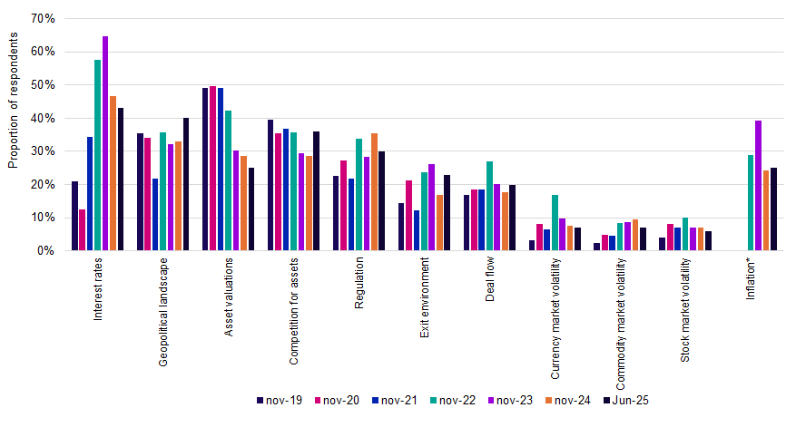
Key challenges for return generation in the next 12 months
Source: Preqin (2025), Investors’ Survey H2 2025

Slide 10
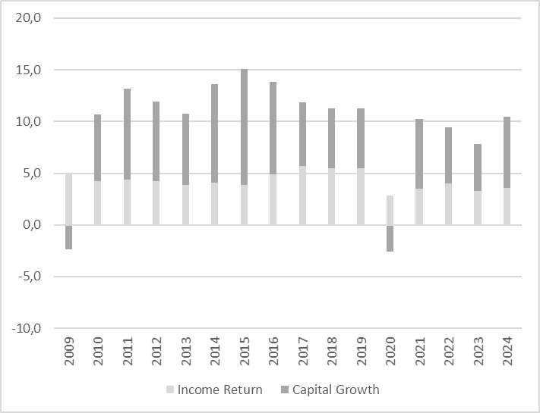
Infrastructure performance (gross total return %, local currency)
Source: MSCI Global Quarterly Private Infrastructure Index, author’s elaboration

Slide 11
THANKS.

